Slide 1
Year in the Life: EIU Students

Slide 2
What the DOS Does
For Students
Advocate for Students
Assist with Personal/Family Issues
Administer Class Absence Notifications
Mental Health
Referrals
Reinforce Student Standards
(Between Students & Professors)
Legal Referrals
& Assistance
Support Personal and Academic Goals
Offering
Campus Events
Developing
Friendships
Sharpening
Leadership
Skills
(Landlord Disputes, Lease Reviews, etc.)
Foster a Sense of Community
Mediate
Disputes
Promote University
Transition Opportunities
Provide Civic
Engagement
Opportunities

Slide 3
WHAT WE MEET WITH
STUDENTS ABOUT
Resources on Campus
Incidents in Housing
Incidents Off Campus
Classroom Behaviors
Academic Dishonesty
Mental Health
Interpersonal Violence
Tickets and Citations
Organizational Misconduct
Violations of the Student Conduct Code

Slide 4
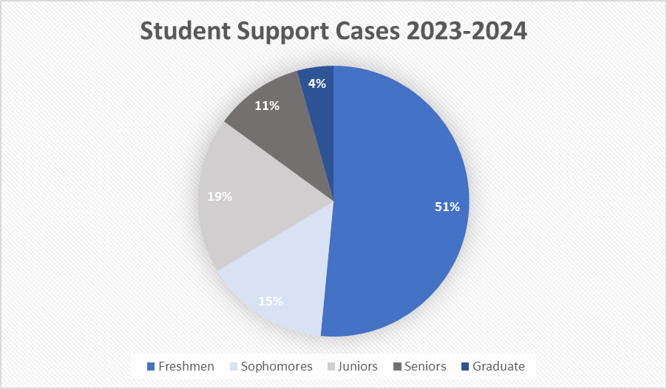
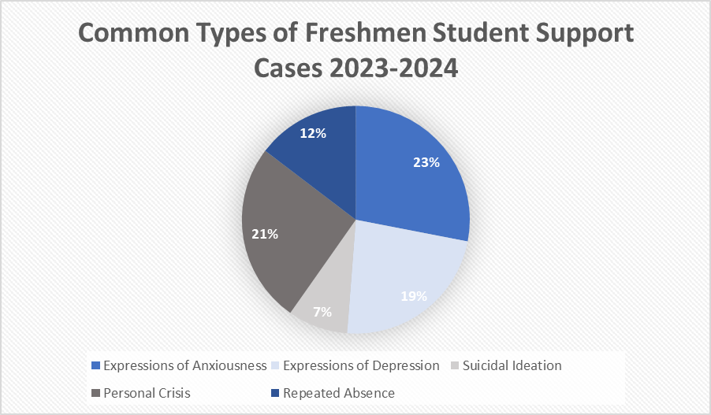
Student Support
Data
164 Total Support Cases During 2023-2024 & 83 Out of the 1093 Freshmen Met With the Dean of Students Office for Support
Percentage Reported of Total Freshmen:
Expressions of Anxiousness (1.7%); Expressions of Depression (1.5%); Suicidal Ideation (.5%); Personal Crisis (1.5%); Repeated Absence (.9%)

Slide 5
Fall Semester
Common Adjustments & Experiences

Slide 6
August
Common Student Issues:
Lifestyle Adjustments
Homesickness/Loneliness
Feeling Overwhelmed
Imposter Syndrome
Common Events/Experiences:
Move-In
Prowl/Welcome Weekend Activities
Potential Party Attendance
First Day of Classes
Pantherpalooza
Meet the Greeks (NPHC/NAFLO)
Last Day to Withdrawal From University for Full Refund (Aug. 30)

Slide 7
September
Common Student Issues:
Homesickness/Loneliness
Feeling Overwhelmed
First Tests/Major Assignments Due
Roommate Conflicts
Common Events/Experiences:
Labor Day (No Classes)
First Home Football Game
Fraternity/Sorority Recruitment (IFC/PHC)
Latino Heritage Month OAIE Events
Apply for Scholarships Through Academic Works
Neighborhood Week (Housing)
Last Day to Withdrawal for 50% Refund (Sept. 16)

Slide 8
October
Common Student Issues:
Academic Stress w/ Midterms
Homesickness/Loneliness
Independence Issues
Time Management Issues Between Socials & Academics
Common Events/Experiences:
Midterms
Meeting w/ Academic Advisors for Spring Classes
Fall Break (No Classes)
Halloweekend Activities
Homecoming
Rising Cases of Academic Dishonesty

Slide 9
November
Common Student Issues:
Struggles to Cope w/ Academic & Social Pressures
"Pre-Finals" Stress Emerges
Increase in Anxiety & Depression
Roommate or Floor Tensions
Time Management
Financial Stress (Bills Need to be Paid In Order to Register for Classes or to See Final Grades, Holds Placed Nov. 1)
Common Events/Experiences:
Family Weekend
Academic Dishonesty Cases Increase
Greek Life Initiations/Formal Events
Thanksgiving Break
Officer Elections for Many Greek Orgs & RSOs
Freshmen Class Registration Opens

Slide 10
December
Common Student Issues:
Illness From Colds/Improper Nutrition & Sleep
Struggles to Cope with Academic Expectations
Increased Anxiety, Fear, & Guilt Due to Final Exams Approaching
Increased Use of Alcohol or Drugs
Increased Depressive or Suicidal Thoughts
Increased Stress Due to Change in Established Routine & Final Grades
Common Events/Experiences:
Negative or Reckless Behavior Increases
Winter Wonderland Student Life Events
Final Exam Week
Winter Break

Slide 11
Spring Semester Common Adjustments &
Experiences

Slide 12
January
Common Student Issues:
Increased Anxiety About Spring Semester Begins
Students w/ Poor Fall Semester Performance Have Increased Pressures to Improve
Increased Feelings of Homesickness for Some
Seasonal Depression/Illness From Cold Weather
Difficulty Getting Back into the Academic Mindset
Common Events/Experiences:
First Day of Classes
Winter Welcome Day Student Life Event
Martin Luther King Jr. Day (No Classes)
MLK Jr. Service Day
Last Day to Withdrawal From University for Full Refund (Jan. 27)

Slide 13
February
Common Student Issues:
Pressure to Improve GPA
Lower Energy Levels
May Think About Changing Majors
Fall Housing Planning
Seasonal Depression
Relationship Anxiety Increases
Common Events/Experiences:
Valentine's Day
Lincoln's Birthday Observed (No Classes)
Recruitment Open Houses or Informationals for Greek Organizations
Finish Applying for Scholarships with March Deadlines
Last Day to Withdrawal for 50% Refund (Feb. 10)

Slide 14
March
Common Student Issues:
Struggles to Cope w/ Academic Pressures
Increased Anxiety/Suicidal Thoughts w/ Midterms
Increased Use of Alcohol and Drugs
Roommate/Friendship Conflicts
Pressure to Make Plans for Spring Break/Negative Thoughts About Missing Out
Common Events/Experiences:
Midterms
Meet w/ Academic Advisor for Fall Classes
Spring Break (Plans or No Plans)
Officer Elections for Many RSOs/Greek Orgs
Rising Cases of Academic Dishonesty

Slide 15
April
Common Student Issues:
Struggles to Cope w/ Academic & Social Pressures
"Pre-Finals" Stress Emerges
Increase in Anxiety & Depression
Roommate or Floor Tensions
Time Management (Extremely Busy Month for Everyone)
Financial Stress (Bills Need to be Paid In Order to Register for Classes or to See Final Grades, Holds Placed April 1)
Common Events/Experiences:
Spring Carnival Events/Spring Concert
Greek Week
Student Appreciation Week
RSO/Greek Awards Night
Many Greek Org Initiations
Academic Dishonesty Cases Increase

Slide 16
May
Common Student Issues:
Increased Anxiety, Stress, Fear, & Self-Doubt
Increased Thoughts of Depression/Suicidal Ideation
Academic Pressures Increase
Relationship Anxiety Over Summer Break Distance
Sadness Towards Missing the Friends & Relationships They Have Built
Struggles w/ Going Home After Experiencing Independence
Increased Stress Due to Packing for Move Out
Common Events/Experiences:
Finals Week
Move Out & Floor Closure

Slide 17
Resources
Health & Counseling Services
Student Success Center: Academic Support Center, Academic Advising Services, Office of Accessibility & Accommodations, Testing & Evaluation, & TRIO Student Support Services
The Writing Center
Student Legal Services
Office of the Registrar
University Police Department
Dean of Students Office

Slide 18
Tips for
Parents/Guardians
Empathy Over Judgement When Problems Arise
Allow for Independence
Resist the Urge to Interfere or Assist with Coursework
Let Your Student Decide Their Classes & Major
Encourage Your Student to Get Involved and Out of Their Comfort Zone
Encourage Your Student to Seek Out Campus Resources
Do Not Hesitate to Step In, When Needed
Call Less Than You Want To

Slide 19
CONTACT INFO
217-581-3827
deanofstudents@eiu.edu
Follow Us on Instagram:

Slide 20
QUESTIONS?

Slide 21
THANK YOU!

